Slide 1
Cell Transport FA
Learning Goal:
Predict movement of molecules through the cell membrane given environmental or cell conditions and describe its affect on a cell.

Slide 2
Tutorials on cell transport
Passive transport
Tutorial on diffusion, facilitated diffusion, and active transport
http://www.sumanasinc.com/webcontent/animations/content/diffusion.html
http://highered.mcgraw-hill.com/sites/0072495855/student_view0/chapter2/animation__how_facilitated_diffusion_works.html
http://highered.mcgraw-hill.com/sites/0072495855/student_view0/chapter2/animation__how_osmosis_works.html
http://highered.mcgraw-hill.com/sites/0072495855/student_view0/chapter2/animation__how_the_sodium_potassium_pump_works.html
http://highered.mcgraw-hill.com/olcweb/cgi/pluginpop.cgi?it=swf::535::535::/sites/dl/free/0072437316/120068/bio02.swf::Endocytosis%20and%20Exocytosis

Slide 3
1 What is diffusion?
Transport of water DOWN its concentration gradient
Transport of solute DOWN its concentration gradient
Transport of solute UP its concentration gradient
Transport of water UP its concentration gradient

Slide 4
2 Pick the following statement that best describes facilitated diffusion.
Movement of water UP its concentration gradient
Using energy to move a solute DOWN its concentration gradient
Movement of solute DOWN its concentration gradient through a protein channel
Moving DOWN its concentration gradient by passing through spaces between phospholipid molecules

Slide 5
3. How is active transport different from passive transport?
Active transport pumps solutes DOWN their concentration gradient
Passive transport does NOT require cell energy, but active transport DOES require cell energy
Passive transport pumps water UP its concentration gradient
Active transport does NOT require cell energy, but passive transport DOES require cell energy

Slide 6
4. True or False. Large polar substances & ions (like Ca2+) cannot move through a cell’s plasma membrane unless they move through a carrier protein because the interior of the membrane is nonpolar.
True
False

Slide 7
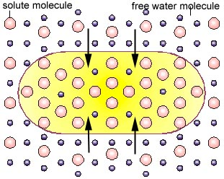
5 When the concentration of solute is lower in the solution bathing a cell than inside the cell’s cytoplasm, environment the solution is _______.
Hypertonic
Isotonic
Hypotonic
Aquatonic

Slide 8
Explanation for # 5 Why are solute & water concentrations INVERSELY related?
Assume the volume of solution
surrounding the cell & the volume
of the cytoplasm are equal. Count
water molecules outside the cell_____ & & inside the cell_____.
Solute takes up space, leaving less
room for water molecules!
If you consider movement of water, is the direction of movement passive—from higher to lower water concentration? ____

Slide 9
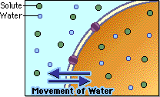
6 When the concentration of the solute is the same on the outside of the cell as it is inside the cell the solution is
Hypertonic
Isotonic
Hypertonic
Aquatonic

Slide 10
Iso- means equal (like in an iso-lateral triangle, two sides have equal length)
Is the concentration of water inside the cytoplasm the same as the concentration of water outside the cell when solute concentrations are equal in both? Yes!
Assume the total volume of the solution outside the cell is equal to that of the cytoplasm. Count the solute molecules inside the cell_____ outside the cell____. Count the number of water molecules inside the cell_____ Outside the cell_____

Slide 11
7 In which direction will the net movement of water be in the following example?
10 % solute
90% H₂O
Into the cell
Out of the cell
equal amounts move into and out of the cell
20% solute 80% H₂O

Slide 12
8 What type of solution is in the environment of the cell?
30 % solute
70% H₂O
Hypotonic
Isotonic
Hypertonic
Aquatonic
10% solute90% H₂O

Slide 13
9 What is the type of environment for this cell?
90
75 % water
25% solute
20% solute 80%
H₂O
Hypotonic
Isotonic
Hypertonic

Slide 14
10. What will be the net direction of water movement?
30 % solute
70% H₂O
Into the cell
Out of the cell
Equal movement into & out of the cell
10% solute
90% H₂O

Slide 15
11 What type of environment is shown?
25 % solute
75% H₂O
Hypertonic
Isotonic
Hypotonic
Aquatonic
20% solute
80% H₂O

Slide 16
Extra The cytoplasm in the cell is
60% H₂O
hypertonic
hypotonic
isotonic
aquatonic
60% H₂O

Slide 17
Extra What type solution is the cell in?
40% solute
Hypertonic
Hypotonic
Isotonic
aquatonic
60% solute

Slide 18
12 What process explains the passive movement of water across a semi-permeable membrane?
Osmosis
Diffusion
Active transport
Facilitated Diffusion

Slide 19
13 Red blood cells & other animal cells which don’t have a cell wall burst if they are in what type of a solution? Small dots are water molecules; larger dots are solute.
Hypertonic
Isotonic
Hypotonic
Aquatonic
?
?
?
?
?
?
?
?

Slide 20
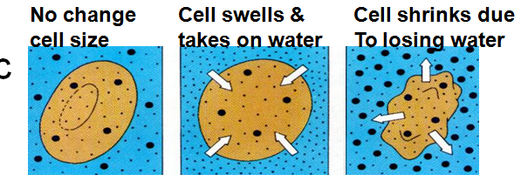
Lower water and higher solute inside cell versus higher water & lower solute outside—water moves down its concentration gradient (high to low)
Equal water and solute concentration in/out; the same amount of water enters & exits because the cell is already at concentration equilibrium.
Higher water and less solute inside versus lower water & higher solute outside—water moves down its concentration gradient (high to low)

Slide 21
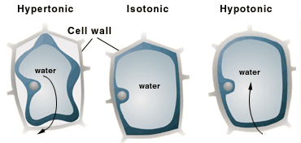
Why don’t plant cells burst after lots of rain makes the soil hypotonic compared to the cell cytoplasm?
Plant cells have aquaporin channels
Plant cells have cell walls
Plant cells have cell membranes

Slide 22
The cell wall of plants presses inwards so that the cell doesn’t take on enough water to burst.

Slide 23
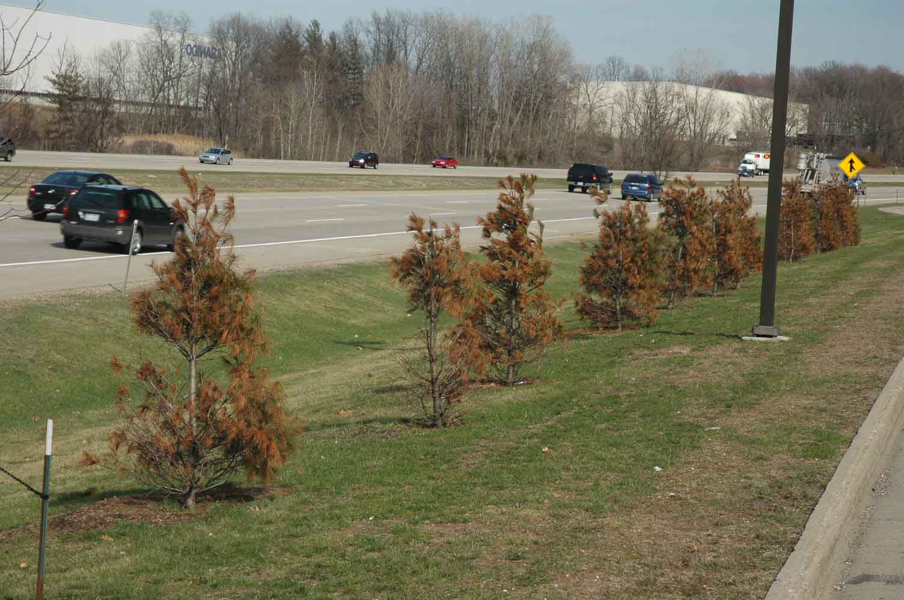
Why do plants die by plasmolysis (plasma membrane breaking) near salted highways and sidewalks?
They burst by taking in too much water from hypotonic soil
They release so much water to the hypertonic soil that their membranes shrink & break

Slide 24
If the cell loses most of the water stored in its large central vacuole, so little pressure is exerted on the cell membrane that it collapses inwards. This tears the cell membrane since it was attached to the cell wall, killing the cell. Plasmo- plasma membrane -lysis - break up

